Slide 1
INTRODUCTION TO COMPUTER SCIENCE
CPT 111
CREDIT UNIT: 2

Slide 2
Module3
Machine Level Representation of Data – Consists of three units:
Unit 1: Units of Data and Fundamental Operations on Bits
Unit 2: Number Bases and Types
Unit 3: Representation of Non-Numeric Data, Records and Registers `

Slide 3
Module 3, Unit 1

Slide 4
Unit 1 Units of Data and Fundamental Operations on Bits
Contents 1.0 Introduction 2.0 Learning Outcomes 3.0 Learning Content 3.1 Units of Information: Bits, Byte and Word 3.2 Measures of Bits and Bytes 3.3 Fundamental Operations on Bits 4.0 Conclusion 5.0 Summary 6.0 Tutor-Marked Assignment 7.0 References/ Further Reading

Slide 5
Units of Data and Fundamental Operations on Bits …
1.0 Introduction
The main use of a computer is to process data into information.
Data – is information in an unorganized and raw form. For the data to be processed, it has to be fed into the computer and then processed in batches.
In this class,
we shall be looking at the various units of data, starting from the smallest basic unit to the largest.
We shall also introduce the fundamental operations that can be performed on the smallest unit of data.

Slide 6
Units of Data and Fundamental Operations on Bits …
2.0 Learning Outcomes
At the end of studying this unit, you should be able to:
Define and explain the concept of bits, bytes and words
Identify and differentiate the different units of information
Perform fundamental operations on bits

Slide 7
Units of Data and Fundamental Operations on Bits …
3.0 Learning Contents 3.1 Units of Information Bit is the shortened form of the term binary digit and it represents information in two states only.
The two states are zeros and ones (0 and 1).
the 0 represents OFF or LOW states while
the 1 represents ON or HIGH states.

Slide 8

Units of Data and Fundamental Operations on Bits …
The two states can be likened to light in a room with two options only,
the lights can be ON or OFF, with no state in between.
Two important factors of a bit are:
its duration and
the difference in voltage levels between the 0 and the 1.
Example 1: Figure showing a string of bits 10110

Slide 9
In example 1 of the previous slide, is displayed a string of 5 bits. A
+5v was used to represent the ON state (1) and
0v used for the OFF state (0).
this is not fixed, and can be +5v for 1 and -5v for 0, +10v for 1 and +5v for 0.
The duration of each bit in the example will depend on the duration of the pulse.
If the pulse lasted for 10 seconds, then
each bit will have a duration of 10/5 = 2 seconds.

Slide 10
Byte - a group of eight bits put together
As the number of bits increases, the amount of information increases
This is because each of the bits can be either LOW or HIGH and the different sequences of ONs and OFFs can be used to convey information.
8 bits put together can be used to represent the various characters in most languages, and this was then adopted to be 1 byte.
A bit is usually represented with a lower case letter ‘b’, while the upper case later ‘B’ is used to represent a byte.

Slide 11
A computer has the capability to process large amount of data at a time.
Feeding just 8 bits (1 byte) to a computer to process at a time is a waste of processing power.
Just like tying a small bucket to a horse to pull.
The number of bits a particular computer can process at a particular time is referred to as word.
For example in a 32-bit computer, the word length is 32 bits and such a computer can address 32 memory locations for processing at a particular point of time.
Other examples of word lengths are 64bits, 16bits etc.

Slide 12
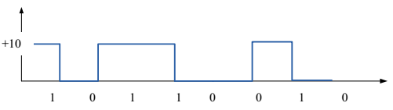
Example 2: Figure showing one byte: 1011010

Slide 13
Self-Assessment Exercise(s) 1. How many states can a bit take?............................................. 2. How many bits make a byte? .................................................. 3. Represent the following graphically: 1001100111 using a +12v for ON and -12v for OFF, let the pulse last for 10seconds.
Self-Assessment Answers (SAA)

Slide 14
3.2 Measures of Units of Information Computers can process and store large amount of data and information. For convenience;
Terms are used to refer to this large aggregate amount of bits or bytes.
Table 1.1 on the immediate next slide shows the various units of information we need to comprehend.

Slide 15
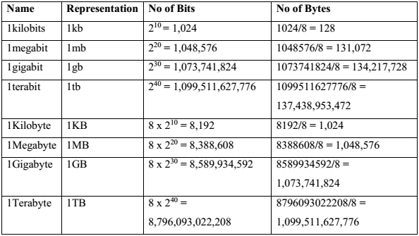
Table 1: The different units of information

Slide 16
Comfortably one transform one unit to the other:
Example 3: Find the number of bytes in 7mb. Solution
First, convert 7mb to bits, which is
7 x 2²⁰ = 7340032 bits.
Then, divide by 8 (1 byte = 8 bits.), thus the number of bytes in 7mb is
7340032/8 = 917504 bytes.

Slide 17
Example 4: A computer network has a download speed of 1MBps. What is the speed in mbps? Solution
Remember that B is for Bytes while b is for bits.
The given speed is 1MBps
Since 1 bytes is equivalent to 8 bits, then 1MB = 8mb.
The download speed of 1MBps is (8 x 1 mbps)
That is, 1MBps is equivalent to 8mbps.

Slide 18
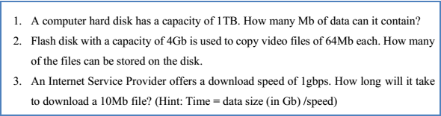
Self-Assessment Exercise(s)
Self-Assessment Answers

Slide 19
3.3 Basic Operations on Bits During processing, a computer manipulates the bits to give a desired result.
This manipulation can be a complex process comprising of simple
basic operations of addition,
basic operations of subtraction,
basic operations of division,
basic operations of multiplication, and
logical operations on bits.

Slide 20
Addition of Bits The addition of bits is similar to the addition of decimal numbers, just that a 2 is treated as a 10, and 1 added to the next bit on the left. The steps you will follow to add two bits together are outlined:
Step 1: Align the bits to be added to the right
Step 2: Start by adding the bits to the far right column
Step 3: Add the bits in each column together, using the rule:
(1+0 = 1, 0+0 = 0, 1+1=0 add 1 to the next column)

Slide 21
Example 5: Add this two bits 10011010 and 11010111
Solution
10010010 + 11010111 101101001
Example 6: Find the sum of these bits 10111001,110101, 10110
Solution
10111001 - 1st Bits + 110101 - 2nd Bits 11101110 - Sum of 1st and 2nd Bits + 10110 - 3rd Bits 100000100 - Sum of 1st, 2nd and 3rd Bits

Slide 22
Subtraction of Bits The subtraction of bits is realized by adding the 2’s complement of the number to be subtracted to the other bit.
The procedure for obtaining the 2’s complement is
Turn all the 0 to 1, and the 1 to 0, Add 1 to the last bit on the right.
After getting the complement, add to the other binary, but ignore any overflow bit.
Overflow bit is the extra bit to the left after the addition.

Slide 23
Example 7: Find 1100 – 1001
Solution
Step 1: Find the 2’s complement of 1001. Flipping all bits gives 0110, adding 1 to the last bit gives 0111.
Step 2: Adding 1100 to the complement 0111.
1100
+ 0111 10011
The last bit to the left is the overflow bit, which is ignored after the addition. Therefore 1100 – 1001 = 0011

Slide 24
Example 8: Find 11001 – 1110
Solution
Step 1: Find the 2’s complement of 01110. Note that it was padded with a 0 to make it equal in length to 11001.
Flipping all bits gives 10001, adding 1 to the last bit gives 10010.
Step 2: Adding 11001 to the complement 10010.
11001 + 10010 101011 The last bit to the left is the overflow bit, which is ignored after the addition.
Therefore 11001 – 1110 = 1011.

Slide 25
Note: It can be observed that the bit after the overflow bit in the two examples is 0. This indicates that the results are positive. If it is 1, then the result is negative. The following example demonstrates a result of a negative value.
Example 9: Find 10010 – 11001.
Solution
Step 1: Find the 2’s complement of 11001. Flipping all bits gives 00110, adding 1 to the last bit gives 00111.
Step 2: Adding 10010 to the complement 00111. 10010 + 00111 11001

Slide 26
Multiplication of Bits The multiplication of binary number can be achieved by a series of shifting and addition. This can be achieved by following these steps:
Step 1: The numbers to be multiplied are aligned to the left
Step 2: The first bit to the left of the second number is used to multiply through all the bits of the first number.
Step 3: You then multiply the second bit of the second number through all the bits of the first, shift the result one bit to the right, and place below the result of step 1.
Step 4: Keep multiplying through until all the bits of the second number have multiplied the bits of the first number.
Step 5: Sum together the results of the multiplication of each bits

Slide 27
Example: Multiply 101101 x 10101
Solution
101101
x 10101
101101
000000
101101
000000
101101
1110110001

Slide 28
Division of Bits The division of bits is done by a series of subtractions of the divisor from the dividend, noting the remainder which is added to the other bits of the dividend. To achieve this, the following steps should be followed:
Step 1: Align the non-zero most significant bits of the divisor and the dividend.
Step 2: Subtract the divisor from the most significant bits of the dividend
Step 3: if a borrow was needed, then the quotient/result is 1, and is 0 if no borrow was needed.
Step 4: If a borrow was needed in step 4, add the divisor to the result of the subtraction to restore the dividend and drop the next significant bit. If no borrow was needed in the subtraction, just drop the next most significant bit to the result of the subtraction.
Step 5: Repeat steps 2 – 4 until all the bits of the dividend have been dropped down and the divisor subtracted and the quotient updated. The quotient and remainder after the last bit is dropped is returned as the result of the division.

Slide 29
Example: Find 101010 / 110
Solution
111
110 101010
-110
1001
-110
110
-110
0

Slide 30
Example: Find 101011 / 11
Solution
111
11 101011
- 11
100
-11
11
-11
01
Therefore, 101011/11 = 111 Reminder 1

Slide 31
Self-Assessment Exercise
1. Solve the following
(a) 0101 (b) 0111 (c) 111010 (d) 1101010
+ 0011 - 0101 ÷101 x 110
2. Find the results of the addition, subtraction, multiplication and division of 1101110 and 1101

Slide 32
4.0 Conclusion
Computers are used to process data into information.
These data are represented in Bits, Bytes and word.
Bits are the basics unit of information and can exist in two states; 0 and 1.
Eight bits of data put together makes a byte, while the amount of bits that a computer can process at a time is known as a word.
Basic operations of addition, subtraction, multiplication and division can be performed on bits.

Slide 33
5.0 Summary In this unit, we learnt:
That data can be represented using bits, bytes and word.
How to convert from one unit of representation to another.
How to perform fundamental operations on bits.

Slide 34
6.0 Tutor-Marked Assignment
Explain the difference between bit, byte and word.
A computer hard disk has a capacity of 2TB. How many mb of data can it contain.
Use hexadecimal notation to represent the following bit patterns:
(a) 0110101011110010 (b) 111010000101010100010111 (c) 01001000
Solve the following (a) 101101 (b) 110110 (c) 1011010 (d) 10101011 + 110001 - 100101 ÷ 1101 x 1101

Slide 35
7.0 References/ Further Readings
Brookshear J. G. (2005), Computer Science: An Overview, 9th Edition, Pearson Addison Wesley.
Norton, P. (2005), Peter Norton's Introduction to Computers, 6th edition, McGraw-Hill/Irwin
Pfaffenberger, B. (2002), Computers in your Future 4th edition, Prentice Hall.
Rajaraman V and Radhakrishanan T, (2009), An Introduction to Digital Computer Design, 5th Edition, PHI Learning Private Limited.

Slide 36
End of Module 3, Unit 1.

Slide 38
Module 3, Unit 2.

Slide 39
Unit 2 Number Bases and Types
Contents 1.0 Introduction 2.0 Learning Outcomes 3.0 Learning Contents
3.1 Base Two (Binary Numbers) 3.2 Base Ten (Decimal Numbers) 3.3 Base Sixteen (Hexadecimal Numbers) 3.4 Integers And Floating Point Numbers
4.0 Conclusion 5.0 Summary 6.0 Tutor-Marked Assignment 7.0 References/ Further Readings

Slide 40
1.0 Introduction In the previous unit,
The bit was introduced to be the shortened form of the binary digit that can exist is two states, 1 and 0.
this can be referred to as a base two number.
The base of a number
refers to the number of numerals or states that the number can contain.

Slide 41
The common bases that are used to represent data in the computer system are the;
base 2 (binary),
base 10 (decimal), and
base 16 (hexadecimal).
This unit will be focusing on the binary, decimal and hexadecimal number bases and the types of numbers.

Slide 42
2.0 Learning Outcomes At the end of this unit, the student will be able to
Express numerical data in base 2, 10 and 16
Convert numerical data from one base to the other
Identify and differentiate the various types of numbers

Slide 43
3.0 Learning Contents 3.1 Binary Numbers (Base two) As previously explained,
a base two number can only exist in two states, 0 and 1.
Each of the numeral is referred to as a bit.
Series of bits put together to represents data that have more than two states.
Table 2.0 shows a string of four bits (known as a nibble, half of a byte) and the decimal equivalent of the various states. See next slide

Slide 44
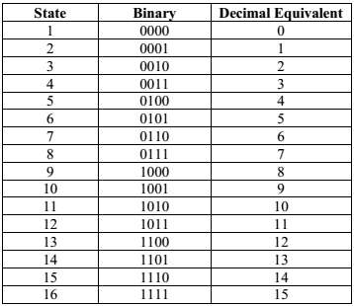

Slide 45
A string of 4 bits can be used to represent 16 states of information to the computer system.
This is from the fact that 2³ = 8.
The base is raised to power 3 because counting the number of bits is from 0 (for the least significant bit) to 3 for the most significant bit.
As such each bit in base two has a value that depends on its position in the binary stream.
Power of Base | 3 | 2 | 1 | 0 | Decimal Equivalent
Binary Number | 1 | 1 | 1 | 1 | 1 x 2³+ 1 x 2²+1 x 2¹+ 1 x 2⁰ = 15
 | 1 | 0 | 1 | 0 | 1 x 2³+ 0 x 2²+1 x 2¹+ 0 x 2⁰ = 10
 | 0 | 1 | 1 | 0 | 0 x 2³+ 1 x 2²+1 x 2¹+ 0 x 2⁰ = 6

Slide 46
As shown in the table in the immediate previous slide;
Conversion of binary numbers to decimal numbers involves
numbering the bits from 0 for the least significant to most significant.
The value of the bit is then used to multiply the base raised to its power;
the higher the number of bits in the system, the greater the amount of states and then data that can be fed into the computer, processed and stored.

Slide 47

Example: Convert 11001010 to a decimal. How many states of information can a byte contain? Solution
The Steps
Step 1 (1x2⁷) + (1x2⁶) + (0x2⁵) + (0x2⁴) + (1x2³) + (0x2²) + (1x2¹) + (0x2⁰)
Step 2 128 64 + 0 + 0 + 8 + 0 + 2 + 0
Step 3 202 202

Slide 48
For the number of states, all the bits are set to 1,
that is 11111111 and when converted to decimal gives 255, but
1 is then added to the 255 to compensate for the 0 state to give 256 states.
Self-Assessment Exercise 1
1. Convert 10101110₂ to decimal number
2. What is the decimal equivalent of 10110001₂?
3. Find the state in each of 1 and 2

Slide 49
3.2 Decimal Numbers (Base 10)
Decimal numbers are the most common base that are used
to present data input to computers and
the output of processing are usually in decimals.
This base has ten states/numerals ranging from 0 to 9.
The position of the numeral also determines its value. The
position 0 is referred to as unit,
position 1 as tens,
position 2 as hundreds,
3 as thousands.
For example the number 529 has 9 units, 2 tens and 5 hundreds all added together.

Slide 50
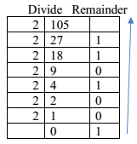
The conversion of a base 10 to base 2 involves
series of division of the base 10 number by 2, and
recording the remainders from bottom to top to yield the base 2 number.
Example, convert the number 75₁₀ in base ten to a number in base 2.
75
37
Read the remainders from bottom to top to obtain 1001011₂

Slide 51
Self-Assessment Exercise(s)
1. Convert 307₁₀ to a base 2 number
2. What is the binary equivalent of 296₁₀?

Slide 52
3.3 Hexadecimal Numbers (base 16)
Hexadecimal numbers have 16 different states/numerals.
It uses a combination of the first ten numerals of the decimal numbers and
The first six alphabets.
This is shown in table 2.3 on next slide

Slide 53
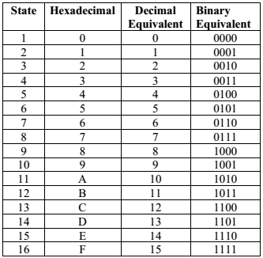

Slide 54
A prefix of 0x before a number shows it is a
hexadecimal number e.g. 0x3A7.
The conversion of a binary number to hexadecimal involves
dividing the binary number into a section of four bits and
each nibble (4 bits stream) converted to its hexadecimal equivalent using table 2.4

Slide 55

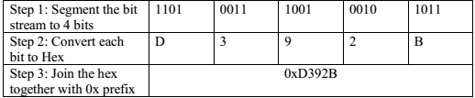
Example: Convert 11010011100100101011 to hexadecimal or hex.
Solution

Slide 56

Conversion to decimal will involve a numbering all the numerals, starting from 0 for the least significant bit. As an example table 2.4 shows the conversion of 0xD392B to decimal
Step 1: Dx16⁴ + 3x16³ + 9x16² + 2x16¹ + Bx16⁰
Step 2: 13x16⁴ + 3x16³ + 9x16² + 2x16¹ + 11x16⁰
Step 3: 851968 + 12288 + 2304 + 32 + 11
Step 4: 866603

Slide 57
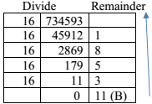
The conversion of decimal to hexadecimal, just like the conversion from decimal to binary, involves series of division (this time by 16) and remainders written from the last to the first gives the hexadecimal number. Example: Convert 734593 to hex. Solution
From the table, 734593₁₀ = 0xB3581.

Slide 58
Self-Assessment Exercise(s)
Use hexadecimal notation to represent the following bit patterns: (a) 1100101111011010
(b) 101010100101010100010111 (c) 01101001
What bit patterns are represented by the following hexadecimal patterns?
(a) 7AD8 (b) 71BD (c) A47D (d) 010A

Slide 59
3.4 Integers and Floating Point Numbers
There are a lot of different types of numbers and each is different from another, yet they may share some common characteristics.
To help keep track of and understand the similarities and differences between numbers,
mathematicians have developed a grouping system that categorizes and describes numbers based on their characteristics.

Slide 60
Some of the most common groups in the system are:
Natural numbers,
Whole numbers,
Integers,
Rationals,
Real numbers

Slide 61
3.4.1 Integers
An integer is a whole number (is not a fractional number) that can be positive, negative, or zero.
Examples of integers are: -6, 2, 8, -95, and 2015.
Examples of numbers that are not integers are: -2.37, 5/7, 3.142, .07, and 45.1.
The set of integers, denoted Z, is formally defined as follows:
Z = {..., -3, -2, -1, 0, 1, 2, 3 ...}.
Integers are represented in computers using two notations:
two’s complement notation and
the excess notation, both of which are based on binary numbers.

Slide 62
In the two’s notation, a fixed number of bits are used to represent the integers.
The number of bits used determines the range of integers that the notation can represent.
Today’s computers use 32 bits and above to represent integers, but we shall be using
a 4 bit system to explain how it works.
The most significant bit (that is the leftmost bit is used to represent the sign of the number,
a 0 is used to represent positive, while
a 1 depicts a negative.

Slide 63
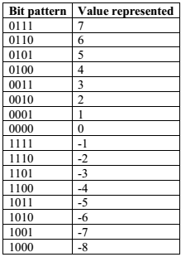
Procedure for 2’s complement of a positive number is:
First to get its binary equivalent,
Secondly flip all the bits (convert 0 to 1, and 1 to 0) and
Finally add 1 to the last bit on the right

Slide 64
A four bit system can only represent the integers from +7 to -8, this is why todays computers use more bits to represent integers.
For example, find how a computer would represent a -14 using its two’s complement.
Step 1: Obtain the binary equivalent of 14, this is 1110
Step 2: Add the sign bit, 01110 (it is zero for the positive 14)
Step 3: Flip all the bits, this results in 10001
Step 4: Add 1 to the last bit, this results in 10010.
Therefore the two’s complement representation for -14 is 10010.
To represent -14, a minimum of five bits is required.

Slide 65
Integers can be represented also using another method known as the excess notation.
To get this notation system, the bit pattern length to be used is identified and the different binary bit pattern listed from 0000…. Upwards.
We then identify the point where the most significant bit changes sign, and assign 0 to that point.
All bit patterns upwards of that point is positive, while those below represents negative integers.

Slide 66
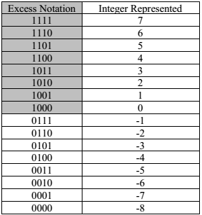
Table 2.7 shows a four bit length used to represent integers using the excess notation, the shaded portion represents the part with 1 as the most significant bit and therefore representing the positive integers.
Positive
Positive of sign
Negative

Slide 67
Self-Assessment Exercise(s)
Find the two’s complement of the following.
(a) -62 (b) 18 (c) -104
State how many bits are required to represent each of the two’s complement in 1.
Design an excess notation system using 5 bits and show the integers it can represent.

Slide 68
3.4.2 Floating Point Numbers
Floating point numbers refers to numbers that are not whole, but contain a part that is less than one (a fractional part).
There is usually a decimal point between the part of the number greater than one and the part that is less.
These numbers are represented to the computer in a form called floating point notation. The highest order bit is designated as the sign bit,
a zero in this bit signifies a positive number, while
a 1 is used to represent a negative number.

Slide 69
The remaining bit is divided into two parts,
the exponent, and
the mantissa.
For example, in an eight bit system,
the first bit is used as a sign bit,
the next 3 are the exponent and
the last four used to hold the mantissa.
Example: If a floating point notation contains 01011101, what does the binary number represent? What is the decimal equivalent of the notation?

Slide 70

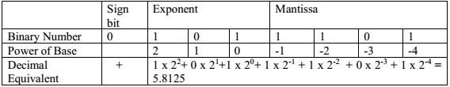
Solution
Break up the given bit stream to the three segments
01011101
The given stream represents a positive bit stream of 101.1101.
To obtain the decimal equivalent, a conversion to decimal using the table below is necessary.
Therefore the bit stream 101.1101 represents 5.8125.

Slide 71
Self-Assessment Exercise (s)
What is the binary number and decimal equivalent of the following floating point notations?
11010001
01110101

Slide 72
The representation in the binary notation can introduce error into the system due to the limited number of bits used to hold both the exponent and the mantissa.
This error is known as truncation error or round-off error.
This error is reduced by using more bits to represent the mantissa field and in today’s computers,
we use at least 32 bits for storing values in the floating point notation instead of the 8 bits used in the examples.

Slide 73
4.0 Conclusion
Numeric data needs to be represented in the computer in a form that it can be processed to give information.
This can usually be done using the base 2, 10, 16 notation depending on the circuitry of the processor of the computer system.
This unit introduced the three common bases numbers which are represented in the computer and also how integers and floating point numbers are handled.

Slide 74
5.0 Summary In this unit, you have learnt:
Binary number representation of numeric data and conversion from base two to base ten.
Decimal number representation of numeric data and conversion from base 10 to base 2
Hexadecimal number representation of numeric data and conversion from base 16 to base ten and base two.
Representation of Integers and Floating point numbers.

Slide 75
6.0 Tutor-Marked Assignment
Convert each of the following binary representations to its equivalent base ten form: (a) 0101 (b) 1001 (c) 1011 (d) 0110 (e) 10000 (f) 10010
Convert each of the following base ten representations to its equivalent binary form: (a) 6 (b) 13 (c) 11 (d) 18 (e) 27 (f) 4
Use hexadecimal notation to represent the following bit patterns: (a) 0110101011110010 (b) 111010000101010100010111 (c) 01001000
What bit patterns are represented by the following hexadecimal patterns? (a) 5FD97 (b) 610A (c) ABCD (d) 0100
Find the two’s complement of the following. (a) -5 (b) 28 (c) -17

Slide 76
7.0 References/ Further Readings
Brookshear J. G. (2005), Computer Science: An Overview, 9th Edition, Pearson Addison Wesley.
Norton, P. (2005), Peter Norton's Introduction to Computers, 6th edition, McGraw-Hill/Irwin
Pfaffenberger, B. (2002), Computers in your Future 4th edition, Prentice Hall
Rajaraman V and Radhakrishanan T, (2009), An Introduction to Digital Computer Design, 5th Edition, PHI Learning Private Limited.

Slide 77
End of Unit 2, Module 3.

Slide 79
Module 3, Unit 3.

Slide 80
Unit 3 Representation of Non-Numeric Data, Records and Registers
Contents 1.0 Introduction 2.0 Learning Outcomes 3.0 Learning Contents
3.1 Non-Numeric Data Representation
3.2 Computer Records And Registers
4.0 Conclusion 5.0 Summary 6.0 Tutor-Marked Assignment 7.0 References/ Further Readings

Slide 81
1.0 Introduction
In the previous unit, number bases were introduced to be the number of numerals or states that the number can contain.
The common bases used to represent data to the computer system are the base 2, base 10 and base 16
This unit will be focusing
on the representation of non-numeric data such as alphabets and special characters, and also
records and registers will be introduced.

Slide 82
2.0 Learning Outcomes At the end of this unit, the student will be able to
Differentiate numeric data from non-numeric data
Explain the various ways non-numeric data is represented in computers
Identify and itemize the functions of records and registers.

Slide 83
3.0 Learning Contents 3.1 Representation of Non-numeric data
Non-numeric data refers data that are not numbers and cannot be arranged sequentially based on their values.
These cannot be added nor subtracted like numeric data and
Examples are alphabets, special characters, images and sound.
The number bases explained earlier are used to represent numeric data to computers, but the representation of
non-numeric data makes use of a coded format.
The coded format for each type is different and can be varied.
This unit will focus on the representation of alphabets and special characters.

Slide 84
The American National Standards Institute (ANSI) came up with the
American Code for Information Interchange (ASCII) which has been adopted widely for coding the representation of letters.
In this code, seven bits are used to represent
the upper and lower case alphabets, punctuation marks and other control functions on the keyboard such as the carriage return, tabs and backspace.

Slide 85
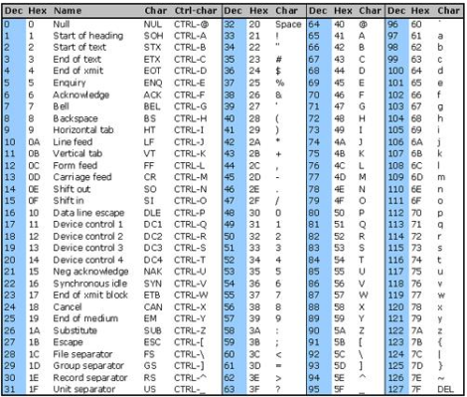
Show in Table 3.1 is the ASCII representation for alphabets and special characters.
From the sequence shown,
the codes for the English letters are in the same sequence as their lexical order.
As such the codes for alphabets can be determined if the codes for the lower and upper case of ‘A’ are known.

Slide 86
Example: What will be the ASCII code (in binary) to represent CODel!
Solution
From the table, you can obtain the decimal code for each of the characters of the word CODel! Then convert each of the decimal code to binary.
Therefore the ASCII code for CODel! is:
100001110011111000100110010111011000100001.
Note, that the case of the letter matters as upper case codes defers from lower case codes.
Letter | C | O | D | e | l | !
Decimal | 67 | 79 | 68 | 101 | 108 | 33
Binary | 1000011 | 1001111 | 1000100 | 1100101 | 1101100 | 0100001

Slide 87
The ASCII code is limited in the number of bits used in the coding.
As such cannot be used to represent the alphabets of languages that have a large number of alphabets such as Chinese and Japanese.
A more recent coding system known as the
Unicode has been developed by leading computer manufacturers which
uses 16 bits to represent each symbol, resulting in 65,536 unique different pattern that can handle languages with large number of alphabets.

Slide 88
The International Organization for Standardization had also developed a code format that uses
32 bits for its encoding.
64 bits for its coding
These can be able to represent billions of different symbols.

Slide 89
Self-Assessment Exercise(s)
What is the ASCII code for FUT, Minna
What does the following ASCII code represents:
1001000 1100101 1101100 1101100 1101111 0101110
(Hint: First convert each segment of seven binary code to decimal, and look up the character it represents in the table).

Slide 90
3.2 Computer Records and Registers
Generally, a record is a combination of various data objects such as
integers, floating point numbers, and character strings that are arranged for processing by a program.
A file contains multiple records and can also be referred to as a data set.
The programming language and/or the application used determines the organization of data in the record.
Typically, records can be of fixed-length or be of variable length with the length of information contained within the record.

Slide 91
A register is a memory location that is built into the central processing unit to speed up its operations by providing access to commonly used values.
They are usually of small value and can be accessed very quickly.
They are made of semiconductor devices whose contents can be read and written to at extremely high speeds but
the contents are held only temporarily, usually while in use or only as long as the power supply is on.

Slide 92
Registers are the fastest way for the system to manipulate data and are at the top of the memory hierarchy.
Registers are normally measured by the number of bits they can contain.
Examples include an 8-bit register (can store 8 bits of data), a 32-bit register (can store 32 bit of data).
There are basically two kinds of registers,
a set of 32 registers that is accessible to a programmer known as the General Purpose Registers) and
another set of 6 registers not accessible to programmers, that is used in interpreting and executing instructions.

Slide 93
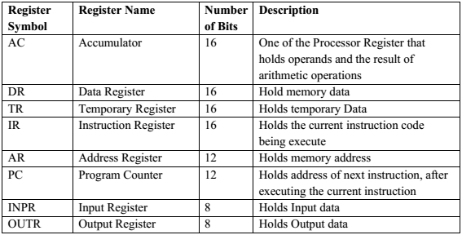
Data and instructions must be put into the system. So we need registers for this.
The basic computer registers with their names, size (for an 8085 microprocessor) and functions are listed below, the size indicate can vary depending on the processor in question.

Slide 94
4.0 Conclusion
Non numeric data refers to raw information that are not numbers and cannot be added and subtracted.
These include alphabets and special characters.
Representation of non-numeric data in computers is done using a coded form.
Various codes are used, common examples include the ASCII and the Unicode.
Computer records are combinations of various data objects such as some integers, floating-point numbers, and character strings that are arranged for processing by a program.
A register is a memory that is built into the central processing unit to speed up its operations by providing access to commonly used values.

Slide 95
5.0 Summary In this unit, you have learnt:
Binary number representation of non-numeric data and conversion from base two to base ten.
Definition of computer records
Definition of computer register and some examples of computer registers.

Slide 96
6.0 Tutor-Marked Assignment
How many bits are used to code special characters using ASCII code? How many characters can be coded using ASCII?
Encode these sentences in ASCII character code:
(a) “Come!” Dr. Musa said (b) Does 4+3=7?
What are computer records?
What are computer registers?
List five examples of computer registers and state their functions.

Slide 97
7.0 References/ Further Readings
Brookshear J. G. (2005), Computer Science: An Overview, 9th Edition, Pearson Addison Wesley.
Norton, P. (2005), Peter Norton's Introduction to Computers, 6th edition, McGraw-Hill/Irwin
Pfaffenberger, B. (2002), Computers in your Future 4th edition, Prentice Hall
Rajaraman V and Radhakrishanan T, (2009), An Introduction to Digital Computer Design, 5th Edition, PHI Learning Private Limited.

Slide 98
END OF MODULE 3

